Slide 1
Processor and I/O Communication

Slide 2
Synchronous Transmission
In synchronous transmission, data moves in a complete paired approach in the form of chunks or frames. Synchronization between the source and target is required so that the source knows where the new byte begins since there is no space between the data.
Synchronous transmission is effective, dependable and is utilized for transmitting a large amount of data. It offers real-time communication between linked devices.

Slide 3
Characteristics of Synchronous Transmission
There are no spaces in between characters being sent.
Timing is provided by modems or other devices at the end of the transmission.
Special syn characters goes before the data being sent.
The syn characters are applied between chunks of data for timing functions.

Slide 4
Examples of Synchronous Transmission
Chatrooms
Video conferencing
Telephonic conversations
Face-to-face interactions

Slide 5
Asynchronous Transmission
In asynchronous transmission data moves in a half-paired approach, 1 byte or 1 character at a time. It sends the data in a constant current of bytes. The size of a character transmitted is 8 bits where a parity bit is added each at the beginning and at the end which makes it a total of 10 bits.
It doesn’t need a clock for integration; rather it utilizes the parity bits to inform the receiver how to translate the data.
It is straightforward, quick, cost-effective and doesn’t need a 2-way communication.

Slide 6
Characteristics of Asynchronous Transmission
Each character is headed by a beginning bit and superseded by one or more end bits.
There may be gaps or spaces in between characters.
Examples of Asynchronous Transmission
Emails
Forums
Letters
Radios
Televisions

Slide 7
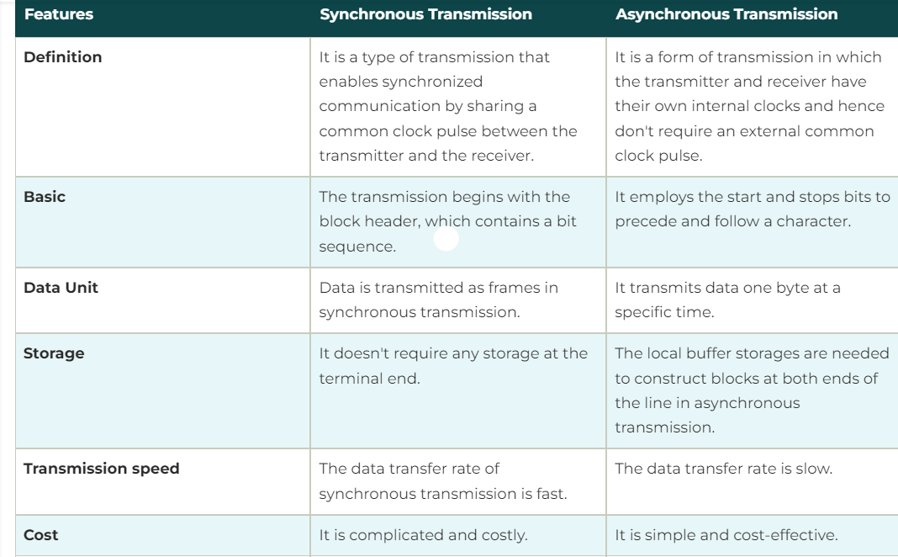
Synchronous and Asynchronous Transmission

Slide 8
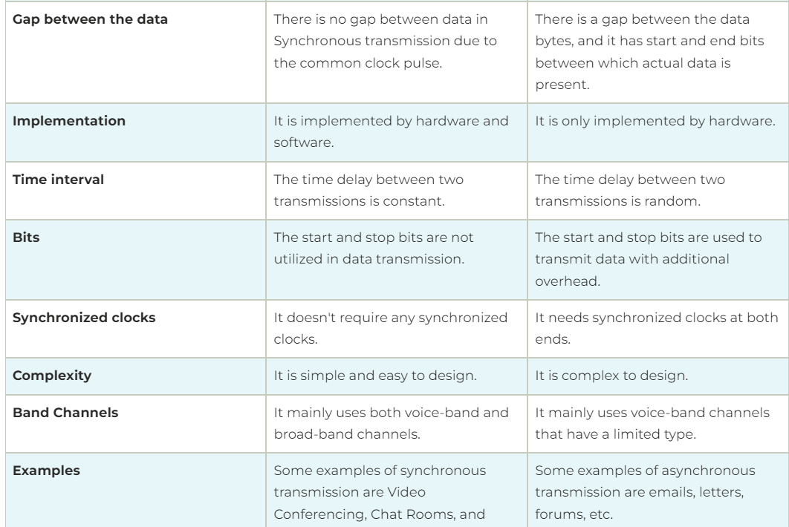
Synchronous and Asynchronous Transmission

Slide 9
Parity Check
A parity check is the process that ensures accurate data transmission between nodes during communication.
A parity bit is appended to the original data bits to create an even or odd bit number; the number of bits with value one.
The source then transmits this data via a link, and bits are checked and verified at the destination. Data is considered accurate if the number of bits (even or odd) matches the number transmitted from the source.
The parity check method is used for error detection.

Slide 10
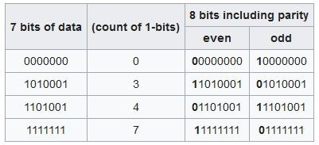
A parity bit, or check bit, is a bit added to a string of binary code to ensure that the total number of 1-bits in the string is even or odd. Parity bits are used as the simplest form of error detecting code.
There are two variants of parity bits: even parity bit and odd parity bit.

Slide 11
In the case of even parity, for a given set of bits, the occurrences of bits whose value is 1 is counted. If that count is odd, the parity bit value is set to 1, making the total count of occurrences of 1s in the whole set (including the parity bit) an even number. If the count of 1s in a given set of bits is already even, the parity bit's value is 0.
In the case of odd parity, the coding is reversed. For a given set of bits, if the count of bits with a value of 1 is even, the parity bit value is set to 1 making the total count of 1s in the whole set (including the parity bit) an odd number. If the count of bits with a value of 1 is odd, the count is already odd so the parity bit's value is 0.

Slide 12
BAUD
Defined as number of signal changes per second, that is the rate at which the serial data is being transferred (bits per second).
Common baud rates are 300, 600, 1200, 2400,
4800, 9600 & 19200.
Bit time is the delay between two successive bits, determined as 1/baud.

Slide 13
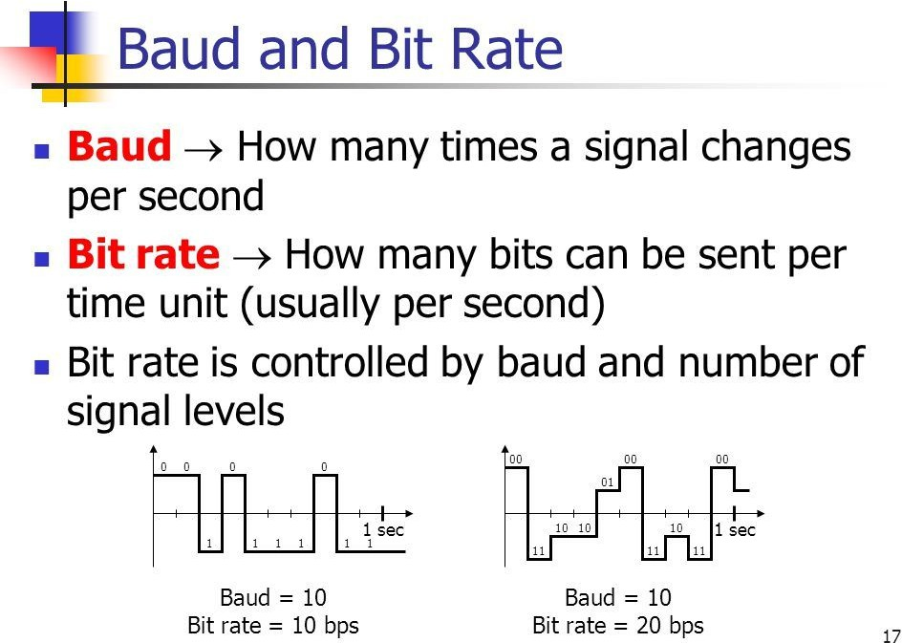

Slide 14
RS 232 Standard
RS-232 (Recommended Standard 232).
The RS-232C standard is an asynchronous serial
communication method.
Serial means that the information is sent 1-bit at a time.
Asynchronous means that no clock signal is sent with the data. Each side uses its own clock and a start and stop bit. Synchronous communication means that a clock signal is sent in addition to a data signal (or interwoven with it)

Slide 15
RS 232 Standard (Cont.)
In RS-232, user data is sent as a timeseries of bits.
Both synchronous and asynchronous transmissions are supported by the standard.
RS-232 devices may be classified as Data Terminal Equipment (DTE) or Data Communication Equipment (DCE), this defines that each device which wires will be sending and receiving each signal.
DTE refers to terminals and computers that sends and receives data.
DCE refers to communication equipment, such as modems, that are responsible for data transferring.

Slide 16
The DTE (computer) transmits the information serially to the other end equipment DCE (modem). In this case, DTE sends binary data “11011101” to DCE and DCE sends binary data “11010101” to the DTE device.
RS232 describes the common voltage levels, electrical standards, operation mode and number of bits to be transferred from DTE to DCE. This standard is used for transmission of information exchange over the telephone lines.

Slide 17
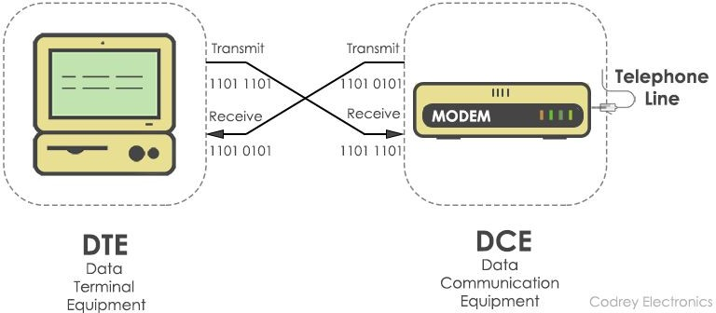
Communication between DTE and DCE

Slide 18
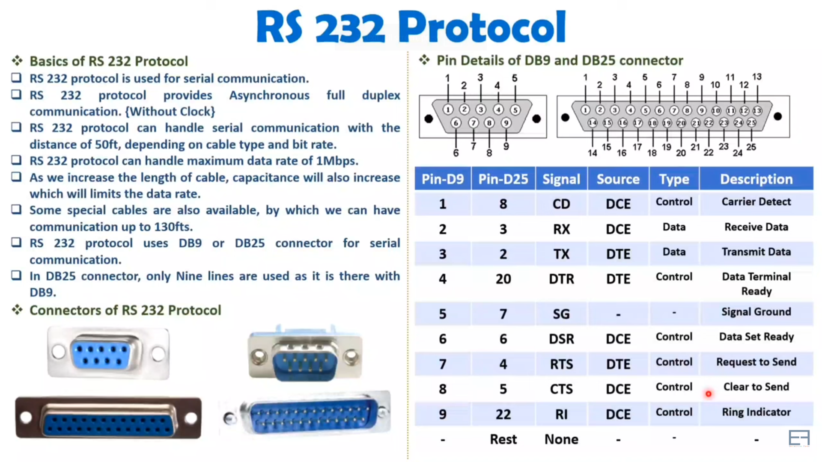

Slide 19
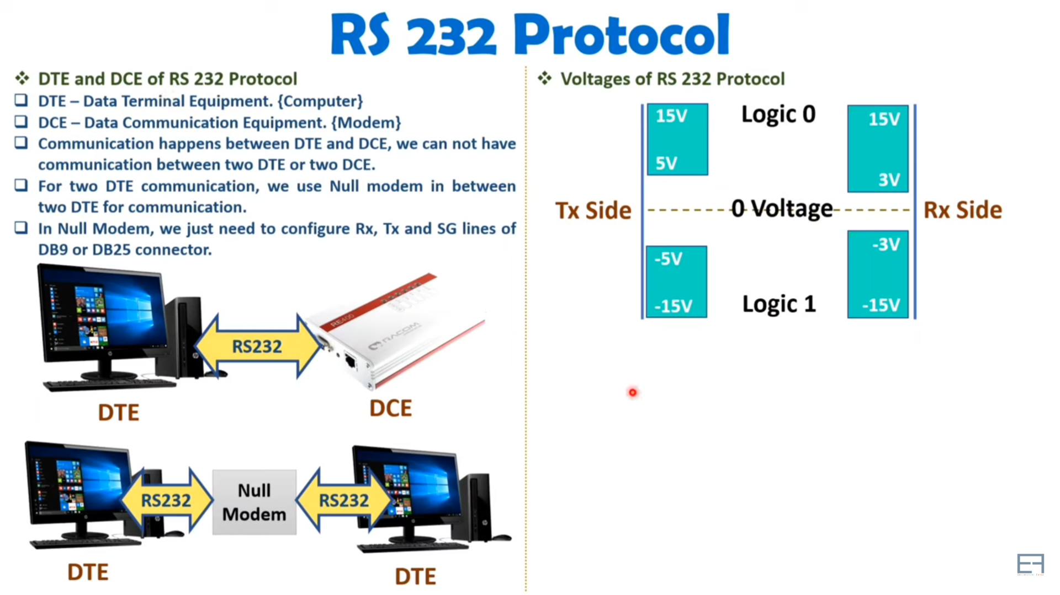

Slide 20
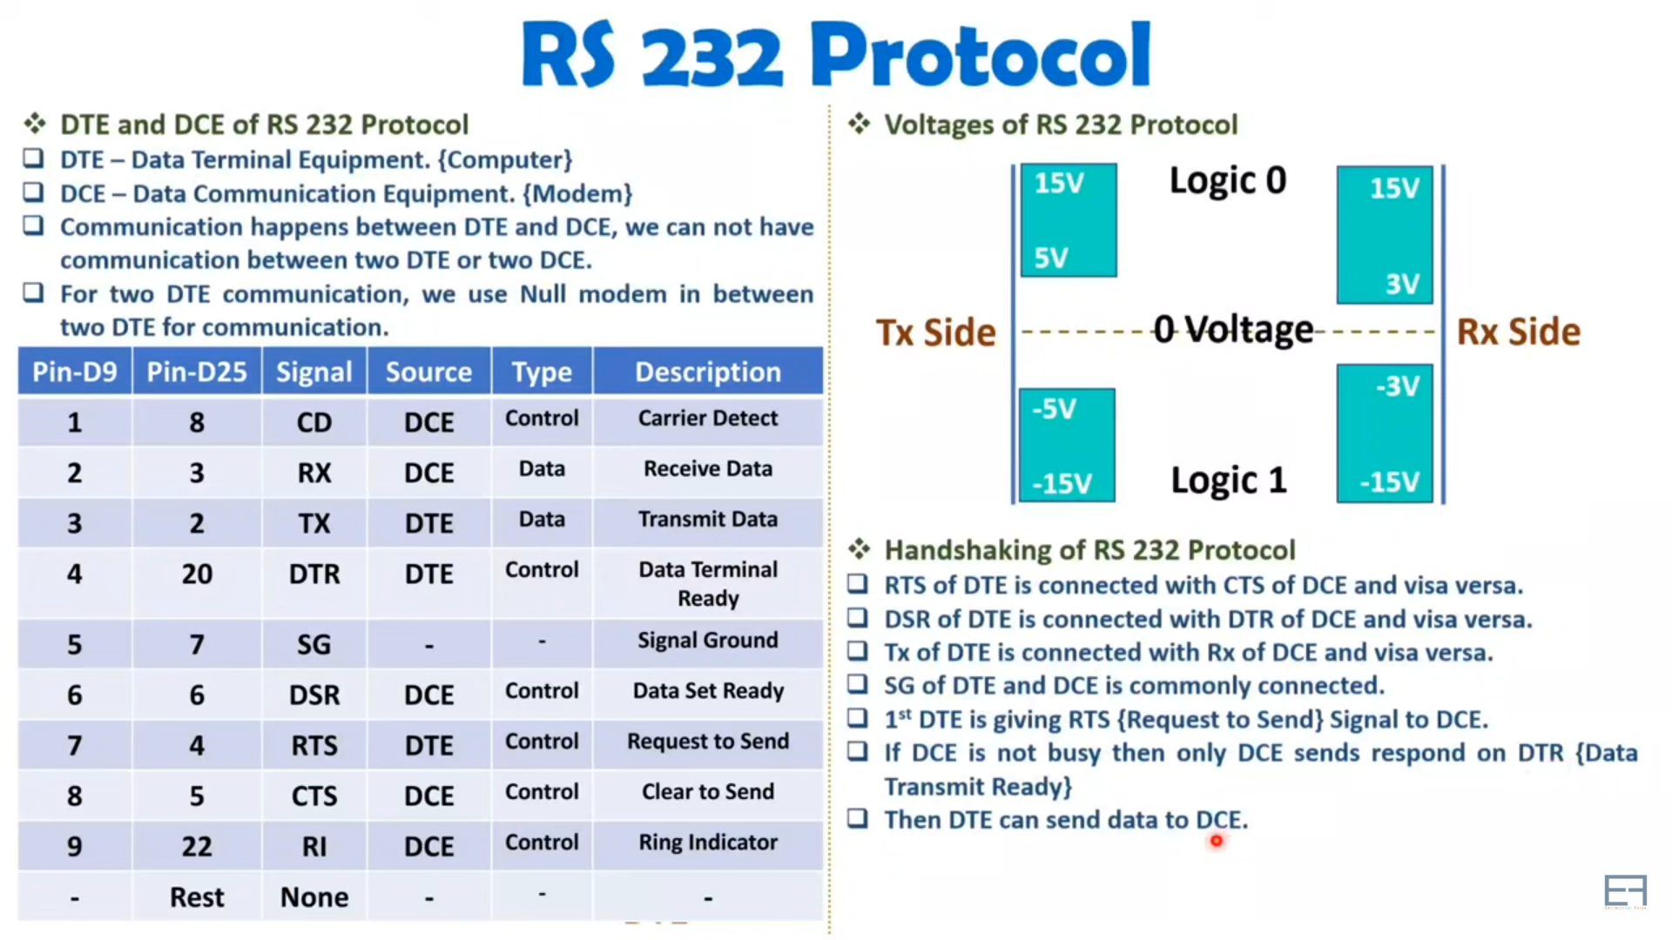

Slide 21
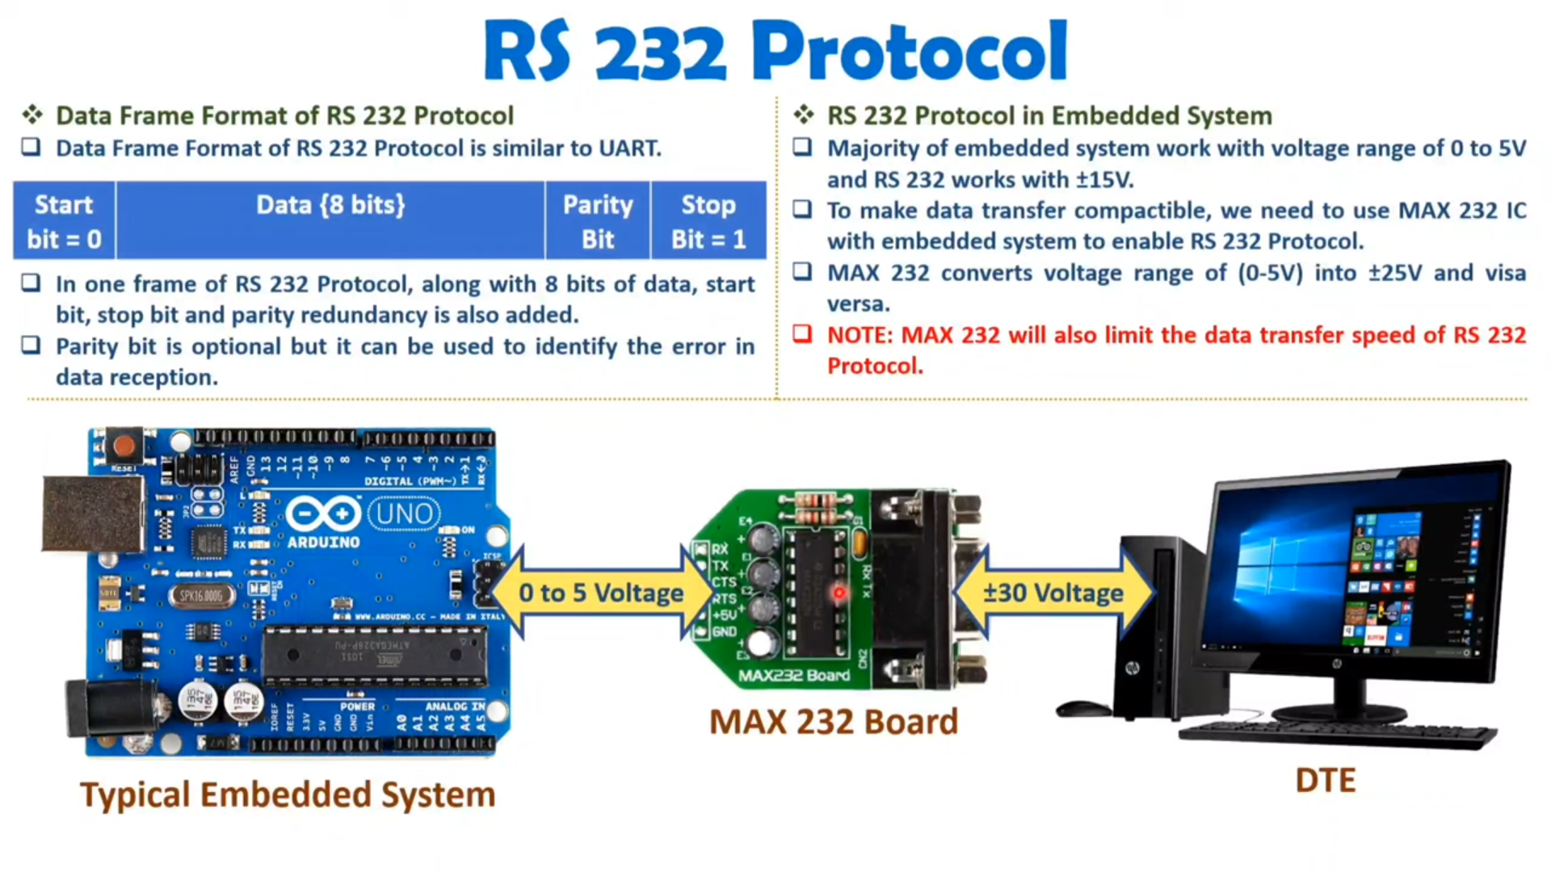

Slide 22
Null Modem
A null modem is a specially designed cable that allows a “head-to-head” connection between two nearby serial devices (computers) through their communication ports (RS-232). Having a length limitation of up to 30 feet, it is most commonly used to connect PCs within the same room for gaming and other purposes such as sending and receiving files.
A null modem is also known as a crossover cable.

Slide 23
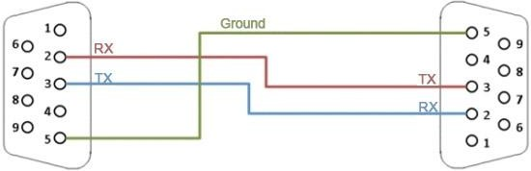
Null modem is a communication method to directly connect two DTEs (computer, terminal, printer, etc.) using an RS-232 serial cable.
Null-modem connections are made possible through the use of a null mode cable. This is the simplest solution to connecting the two computers.
The null modem cable is comprised of three lines. One wire serves as the signal ground with the other two lines fostering the transmitting and receiving of your data. Based on the software used in this connection, some kind of authenticating handshake may be necessary.

Slide 24
Limitations of the Standard
The limited transmission speed, relatively large voltage swing, and large standard connectors motivated development of the universal serial bus(USB) which has displaced RS-232.
Multi-drop connection among more than two devices is not defined.
Also multi-drop have limitations in speed and compatibility.

Slide 25
8251 Programmable Communication Interface
8251 is a programmable device to perform either synchronous or asynchronous serial communication , called as universal synchronous asynchronous receiver transmitter - USART.

Slide 26
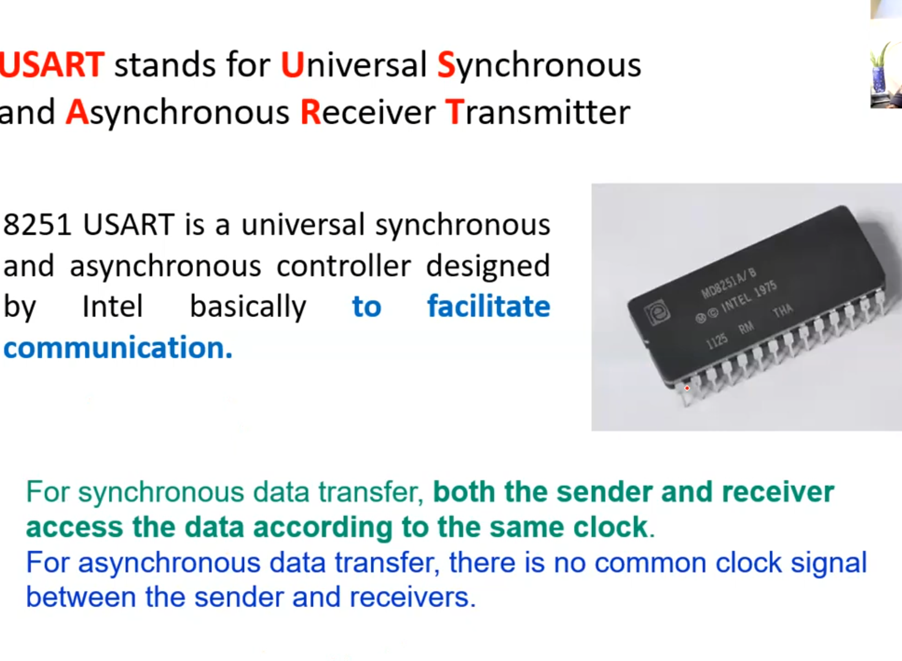

Slide 27
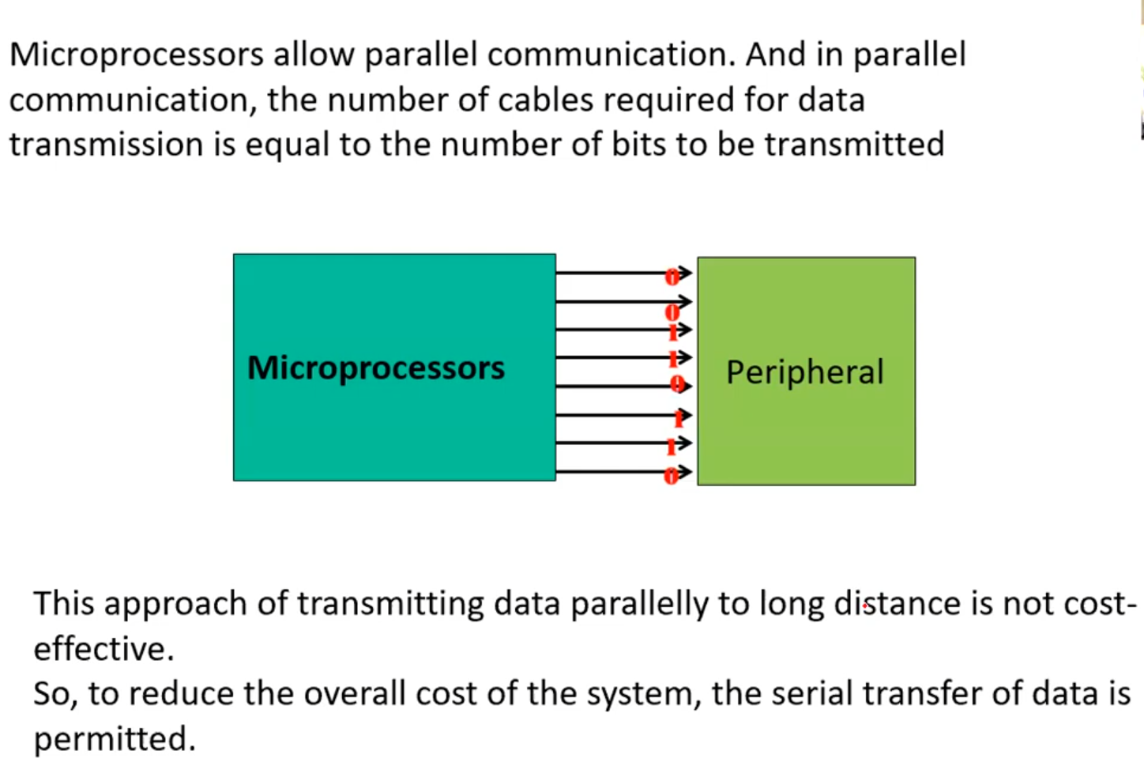

Slide 28
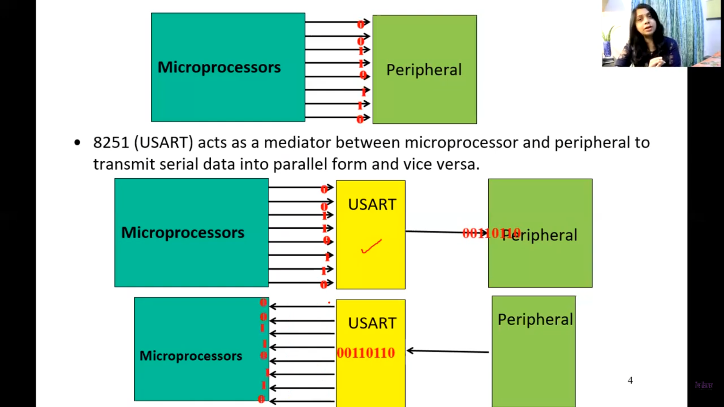
Peripherals to

Slide 29
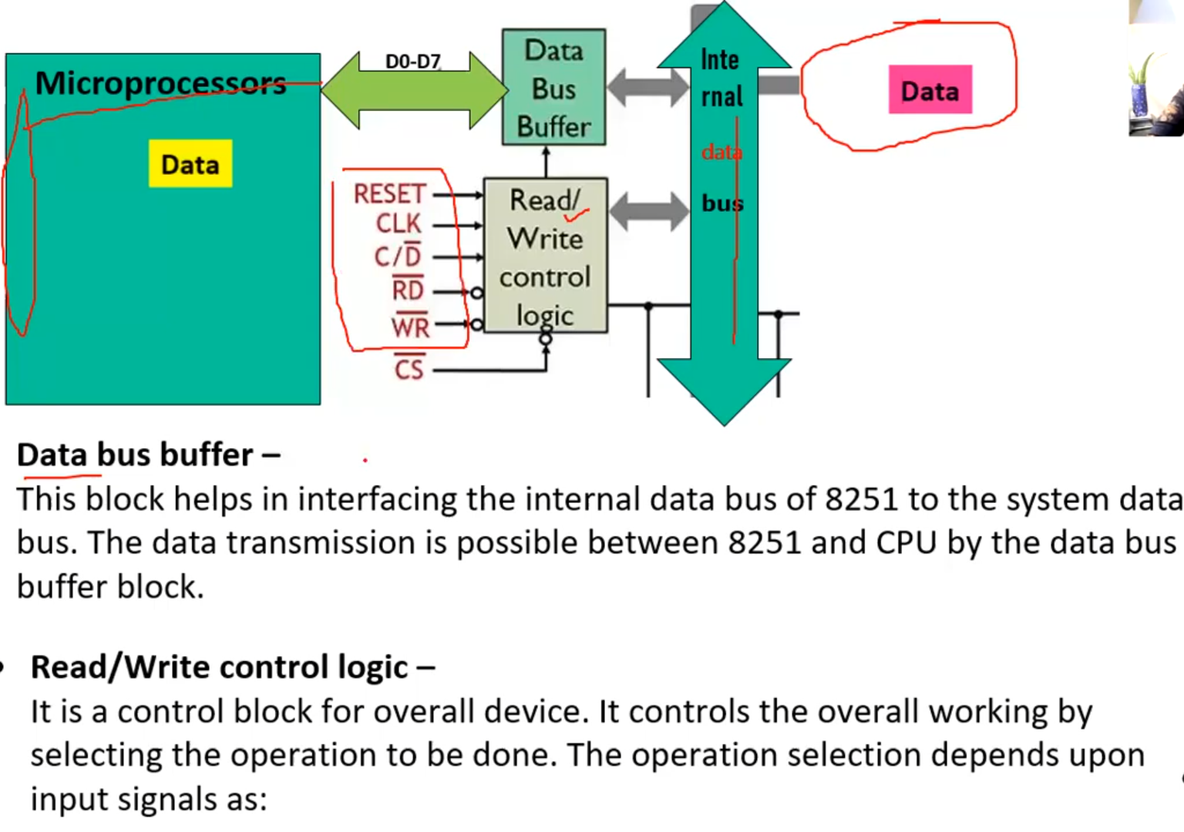
Peripherals to

Slide 30
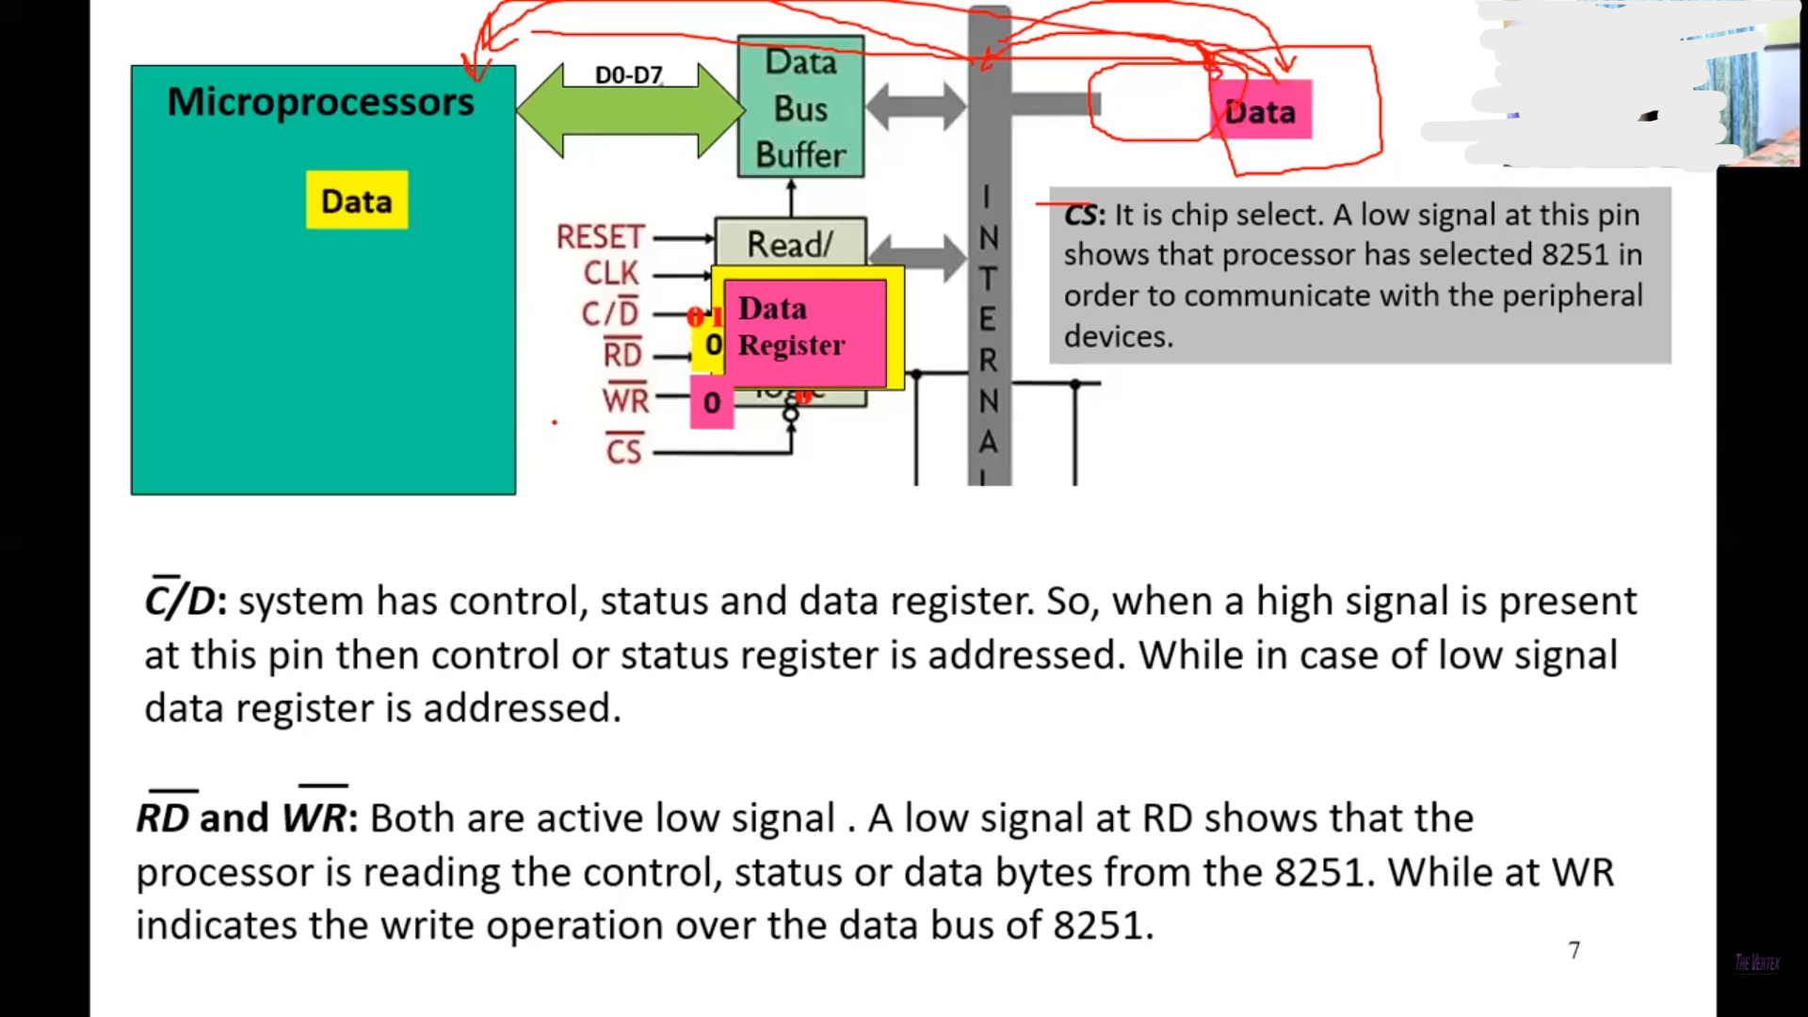

Slide 31
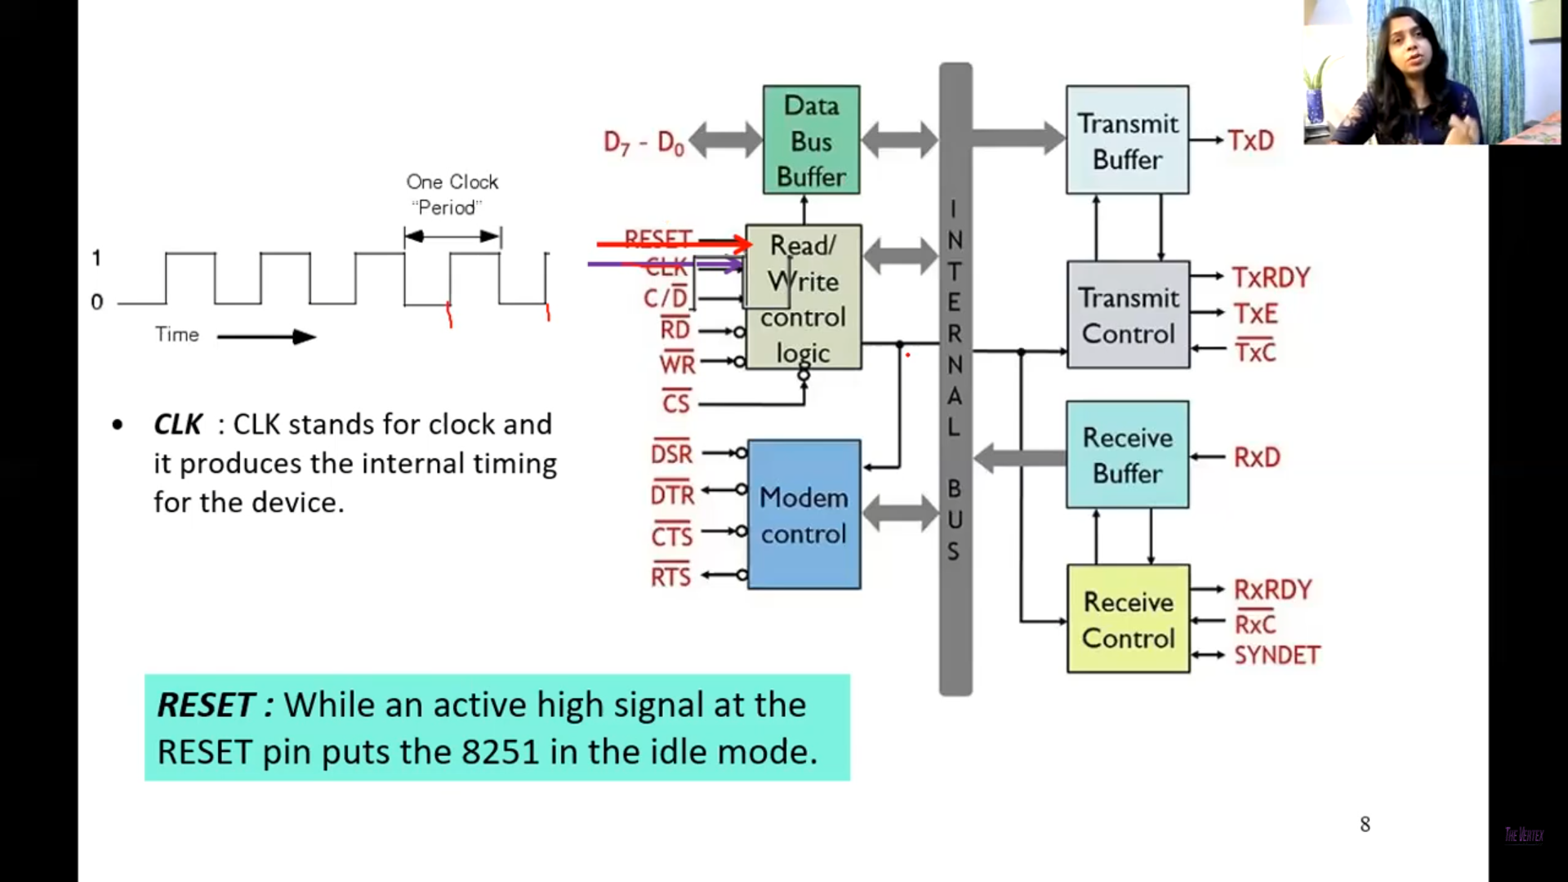

Slide 32
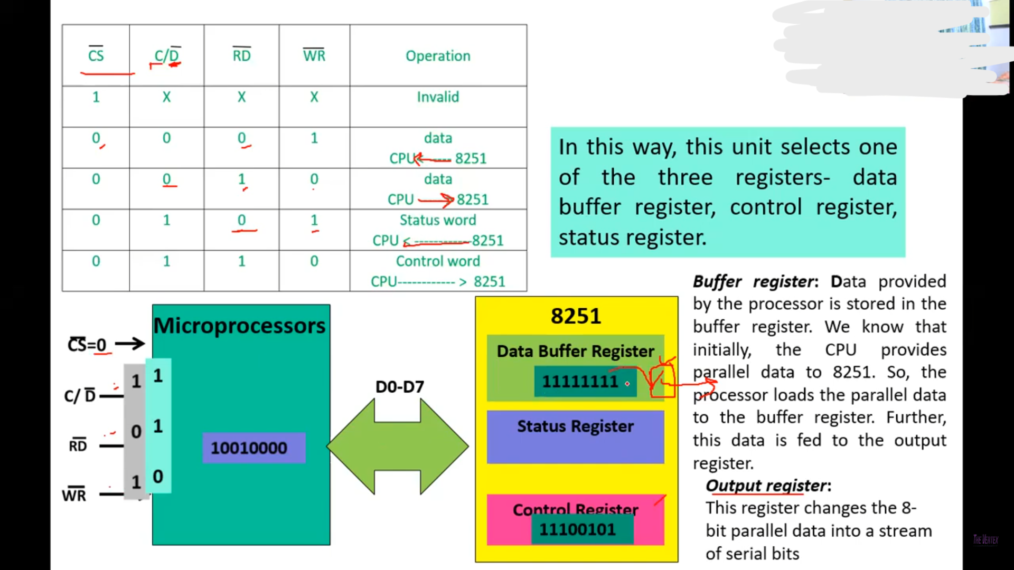

Slide 33
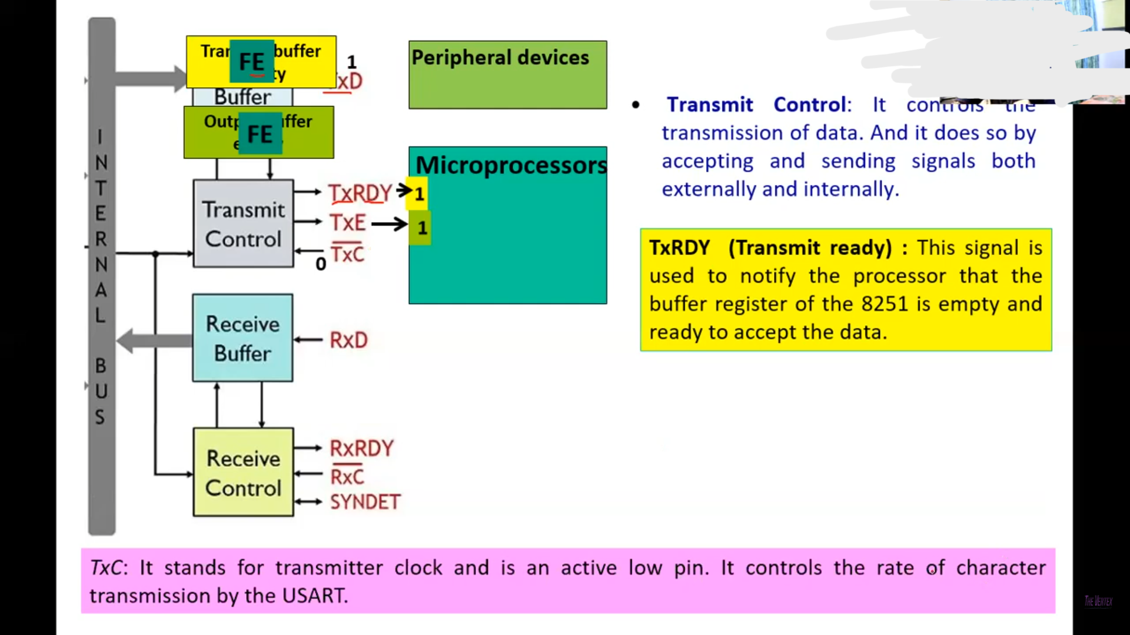

Slide 34
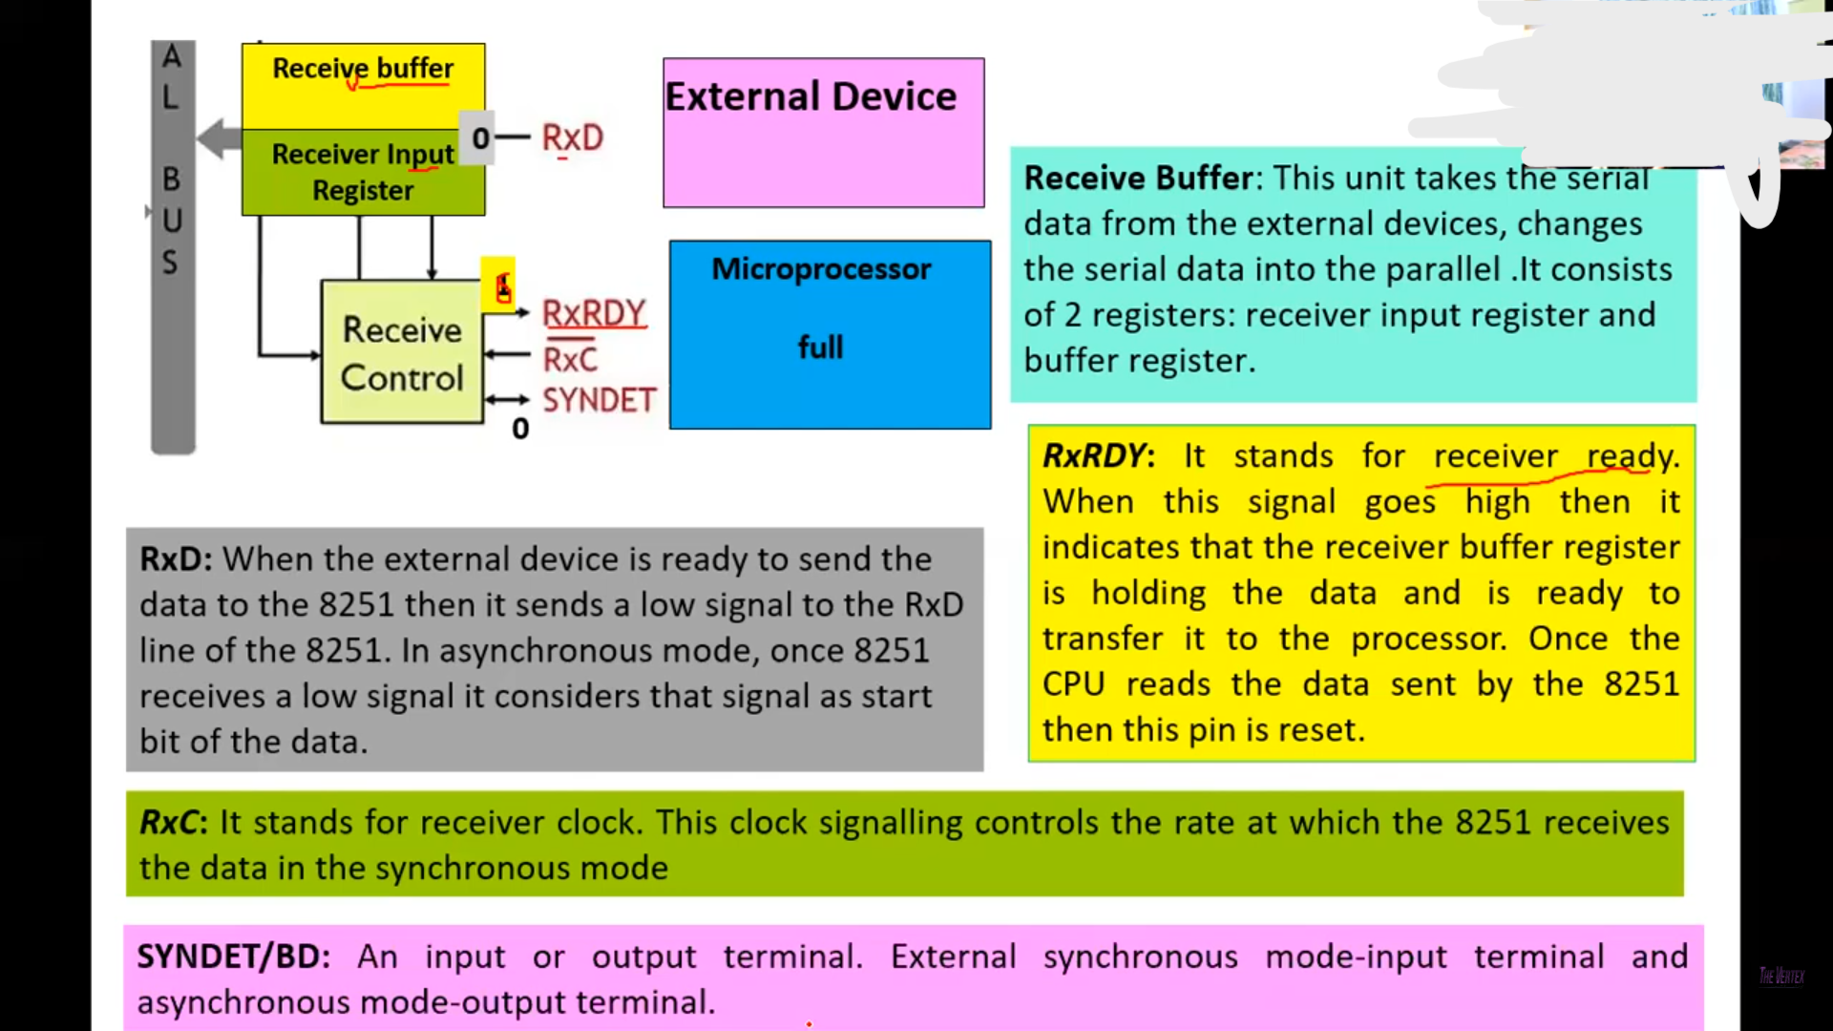

Slide 35
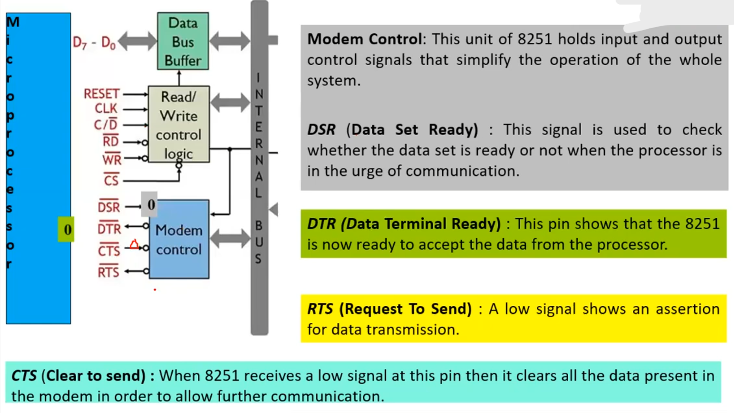

Slide 36
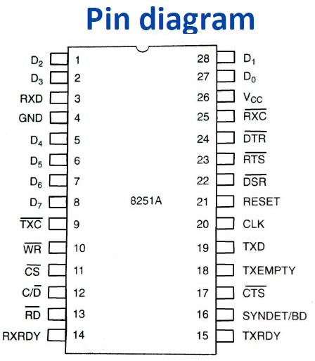

Slide 37
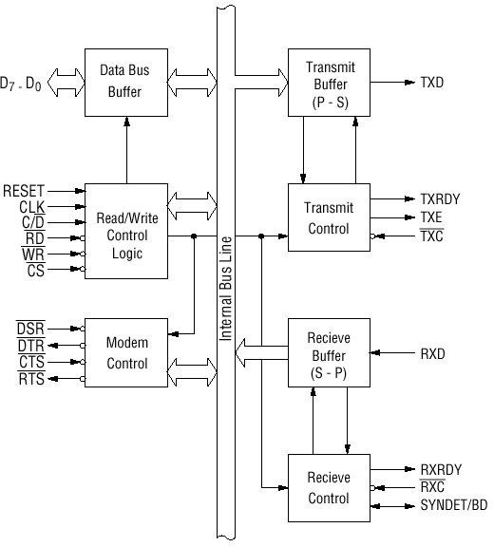
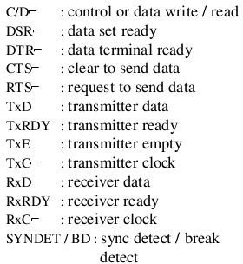
8251: Block diagram

Slide 38
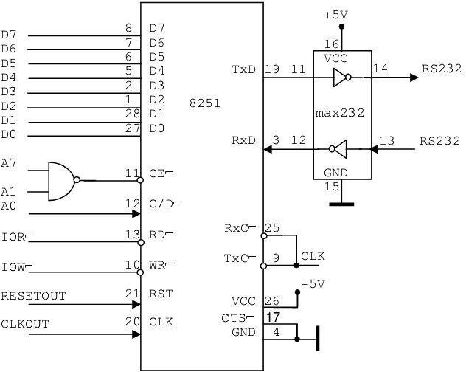
Interfacing RS 232 Terminal using the 8251A

